Slide 1
Assignment 1-2 Tableau
File created on: 3/25/2021 8:49:45 AM

Slide 2
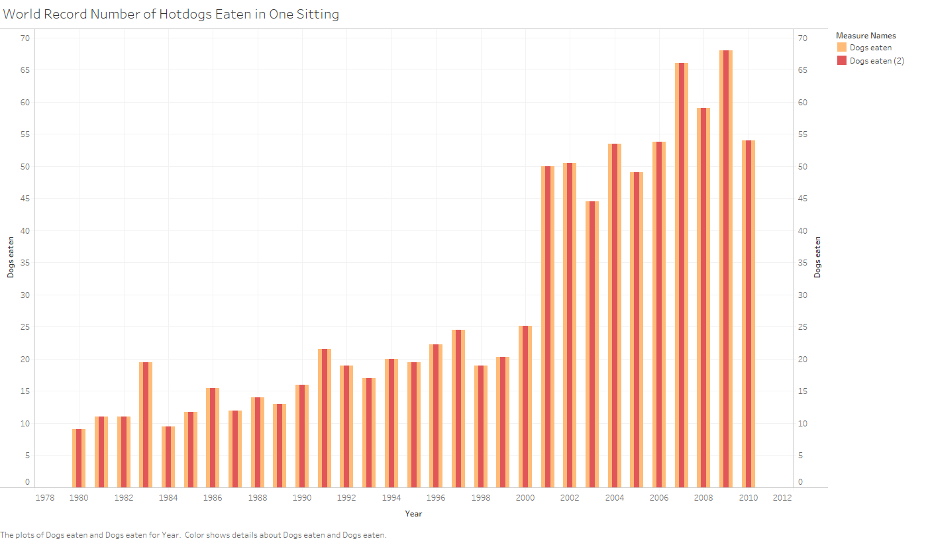

Slide 3
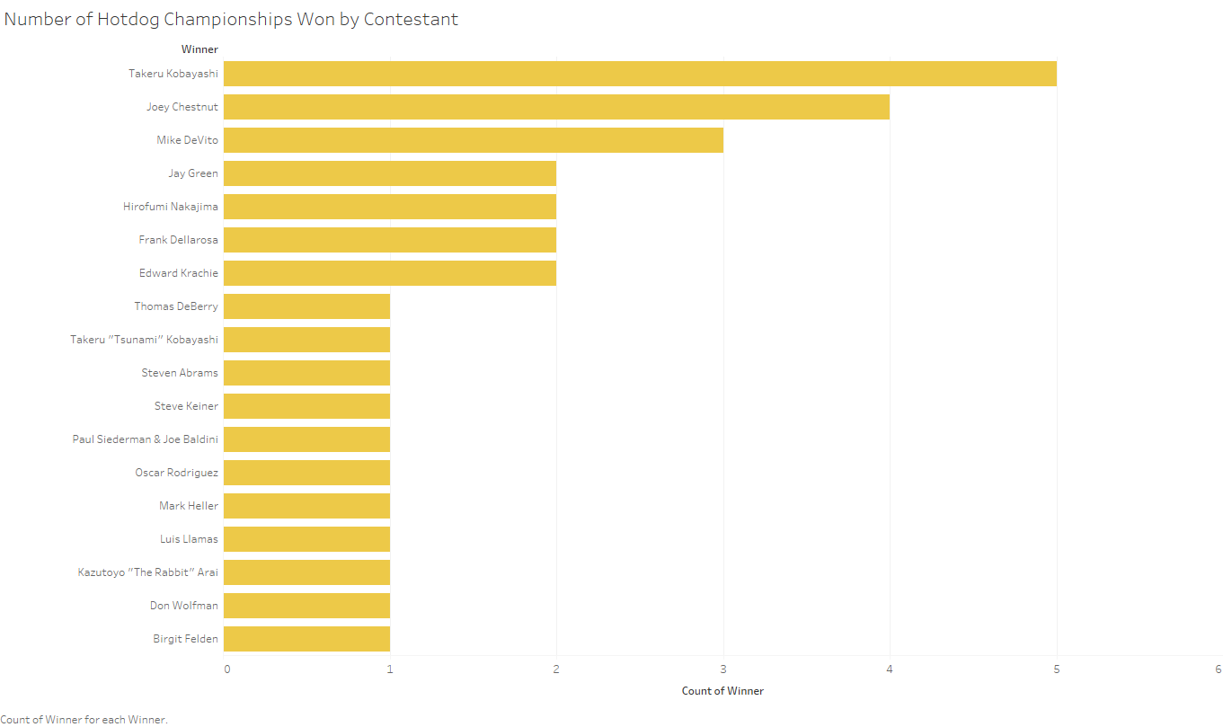

Slide 4
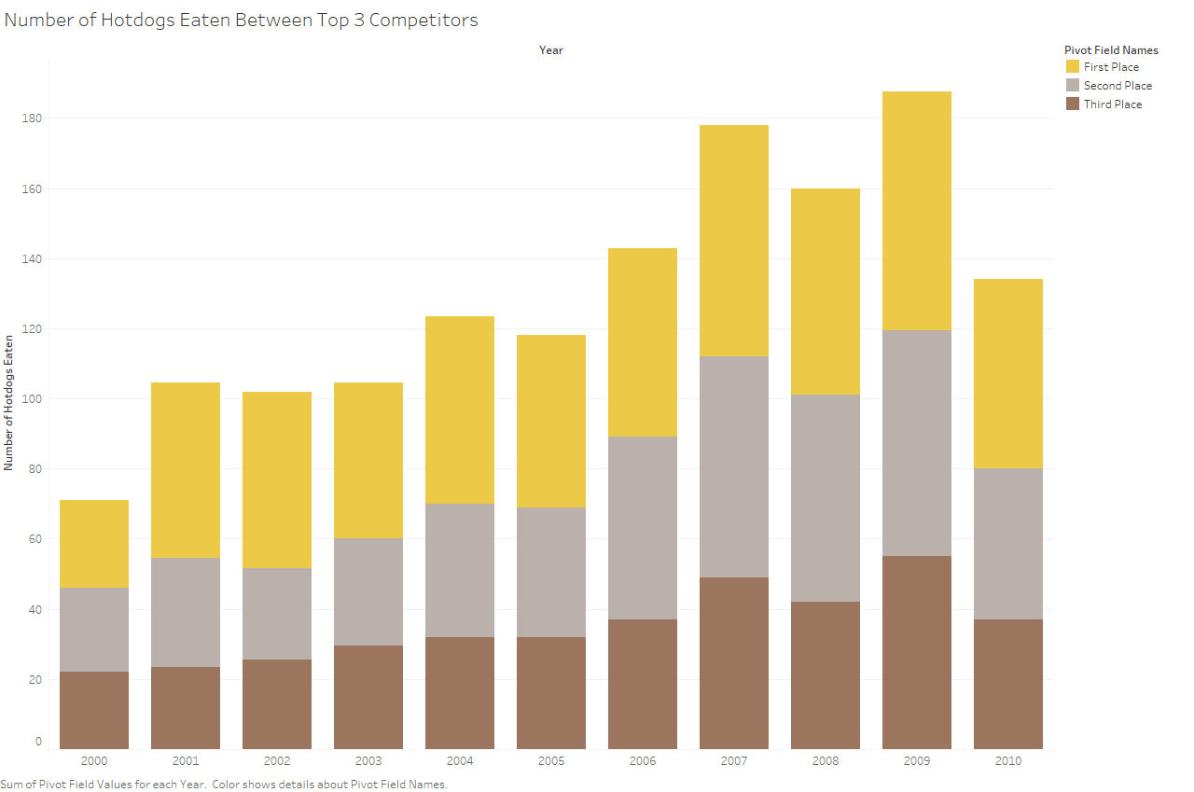

Slide 5
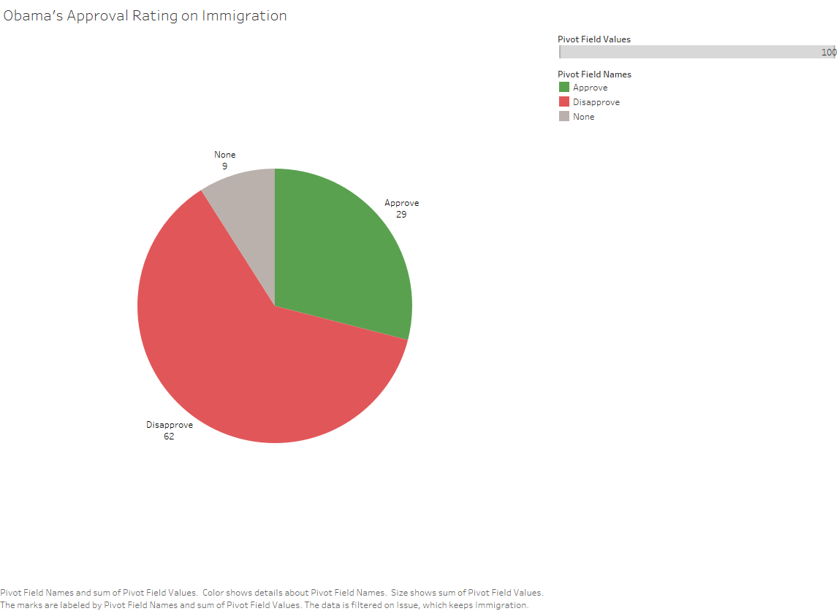

Slide 6
